Slide 1
Traffic Management System
Process Design
ISD Project: CSE A2
Student IDs: 1005032
1005036
1005042
1005050

Slide 2

Topics
Sequence Diagram
State-Chart Diagram
Activity Diagram

Slide 3
Subsystems
Complain subsystem
Highway Network Updating Subsystem
City Network Updating Subsystem
Query Subsystem

Slide 4
Complain Subsystem

Slide 5
Activity Diagram: Complain Use-case

Slide 6
Sequence Diagram: Complain use case

Slide 7
State-Chart Diagram: Complain Use-case
<<entity>>:ComplainInfo

Slide 8
Activity Diagram: Notification Use-case

Slide 9
Sequence Diagram: Notification use case

Slide 10
State-Chart Diagram: Notification Use-case
<<entity>>:ComplainInfo

Slide 11
Thank You

Slide 12
Highway Network Updating Subsystem

Slide 13
Activity Diagram: Highway Update Use-case

Slide 14
Sequence Diagram: Highway Update use case

Slide 15
State-Chart Diagram: Highway Update Use-case
<<entity>>:HighwayUpdateSystem

Slide 16
City Network Updating Subsystem

Slide 17
Activity Diagram: City Update Use-case

Slide 18
Sequence Diagram: City Update use case

Slide 19
State-Chart Diagram: City Update Use-case
<<entity>>:CityUpdateSystem

Slide 20
Activity Diagram: Login Use-case

Slide 21
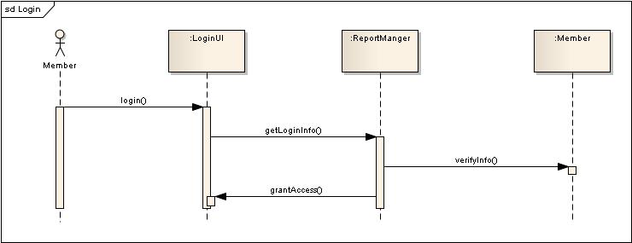
Sequence Diagram: Login use case

Slide 22
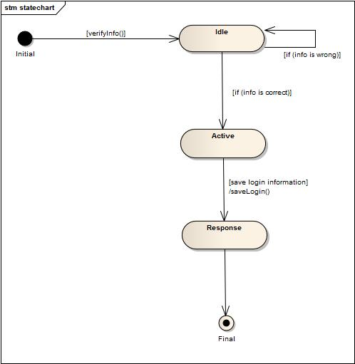
State-Chart Diagram: Login Use-case
<<entity>>:Member

Slide 23
Query Subsystem

Slide 24
Activity Diagram: Highway Query Use-case

Slide 25
Sequence Diagram: Highway Query use case

Slide 26
State-Chart Diagram: Highway Query Use-case
<<entity>>:HighwayQuerySystem

Slide 27
Activity Diagram: City Query Use-case

Slide 28
Sequence Diagram: City Query use case

Slide 29
State-Chart Diagram: City Query Use-case
<<entity>>:CityUpdateSystem

Slide 30
END OF SLIDES

